Slide 1
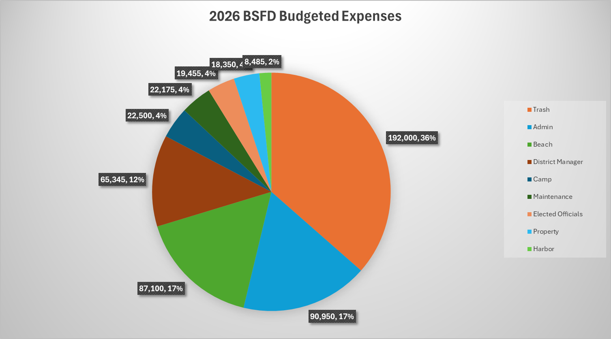

Slide 2
RHODE ISLAND STATE LAW ON CAPS ON TAX INCREASES
R.I.G.L. § 44-5-2. Maximum levy.
In its fiscal year 2013 and in each fiscal year thereafter, a city or town may levy a tax in an amount not more than four percent (4%) in excess of the total amount levied and certified by that city or town for its previous fiscal year.

Slide 3
BSFD CHARTER SECTION 7
The district may raise money by taxation or real estate, and buildings or improvements upon leased real estate within the district, provided, that the tax assessed and payable in any one (1) year under the provisions of this act shall not exceed seven (7) mills on each dollar of valuation as hereinafter defined.
(1932)

Slide 4
FISCAL RESPONSIBILITY
Do We Need a Cap on Tax Increases
ASSESSED VALUE OF PROPERTIES IN BONNET
Buildings: $439,318.00*
Land: $562,679.00*
Total: $1,137,332,800.00*
2025-2026 Budget: $534,000
2025 mil rate: 0.00046952
Max mil rate under the 1932 Charter: 0.00700000 = $7,961,329.60
*From BSFD Tax Roll July 2025 plus 5 additional properties added that were omitted from the tax roll

Slide 5
Current vs Maximum Mil Rate Comparison
2025 mil rate = .00046952
Max. mil rate = .00700000
Assessed value 2025
$4,212,500 = $1,977.85 FD Tax
$2,543,700 = $1,195.00 FD Tax
$1,618,500 = $759 FD Tax
$1,000,012 = $469.53 FD tax
$594,300 = $279.036 FD Tax
Assessed value 2025
$4,212,500 = $29,487 FD Tax
$2,543,700 = $17,805 FD Tax
$1,618,500 = $11,329 FD Tax*
$1,000,012 = $7,000 FD Tax
$594,300 = $4,160 FD Tax
*FD Tax would be higher than the Narr. Tax. For example, Narr. Tax rate at 6.79% per thousand: $1,618,500 = $10,989.

Slide 6
Mechanism:
Bylaw to implement a cap on tax increases
A levy cap would allow the district to cap any increase in its property tax at the maximum amount _______over the previous year’s amount that is budgeted to be raised by taxation, or by the amount of annual inflation per the CPI index.
The district may increase the amount by taxation greater than the cap or the annual inflation rate, if the increase is approved by the people through a referendum at the Annual Meeting.
At the present time, the people do not have the opportunity to vote on the budget or tax increases.

Slide 7
Financial Food for Thought
Discussion to be Continued

